Slide 1
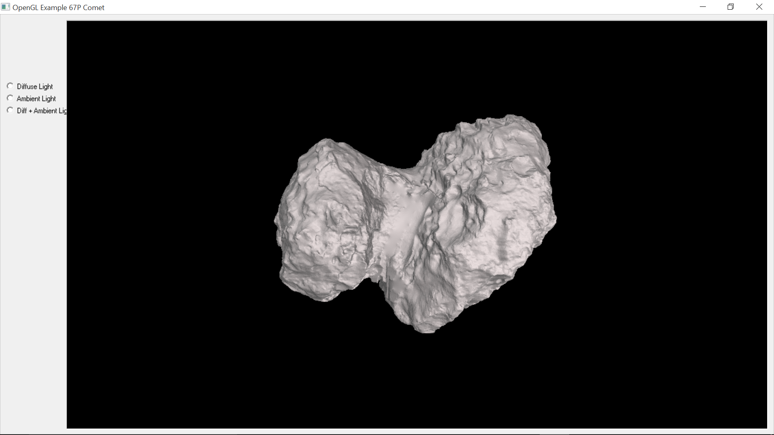
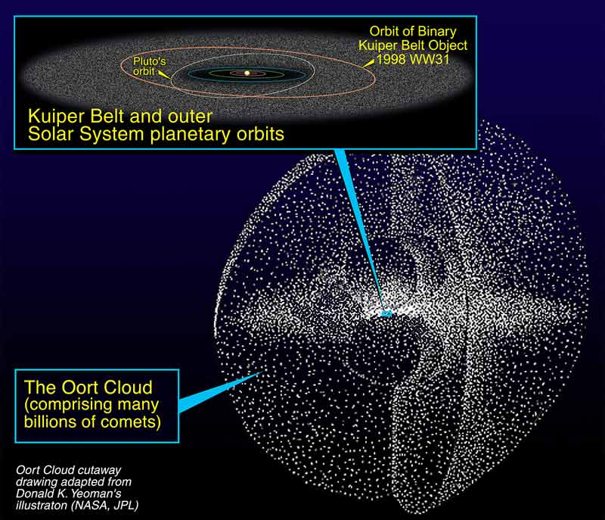
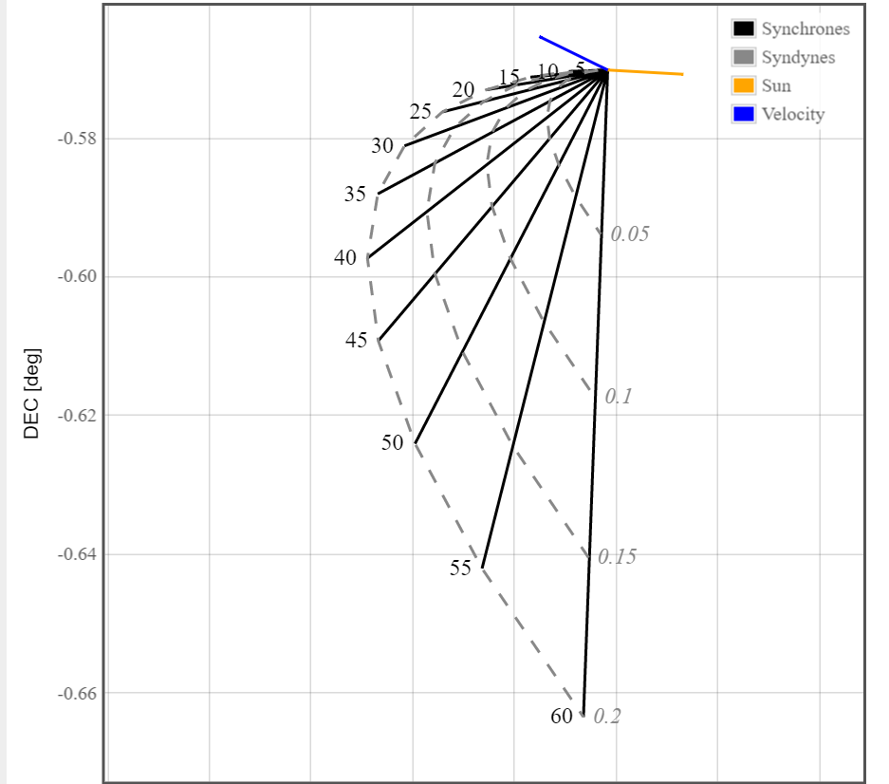
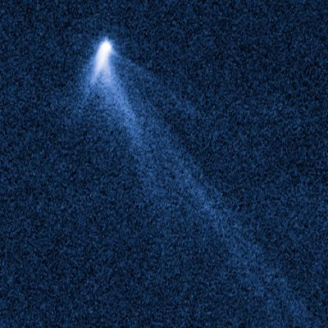
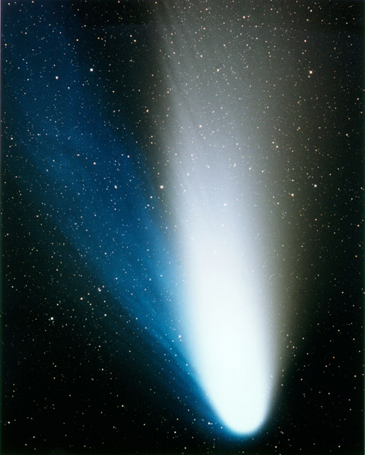
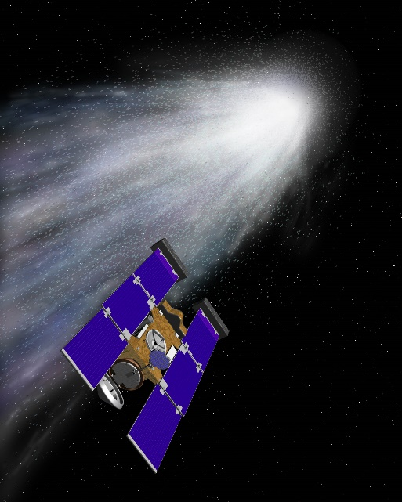
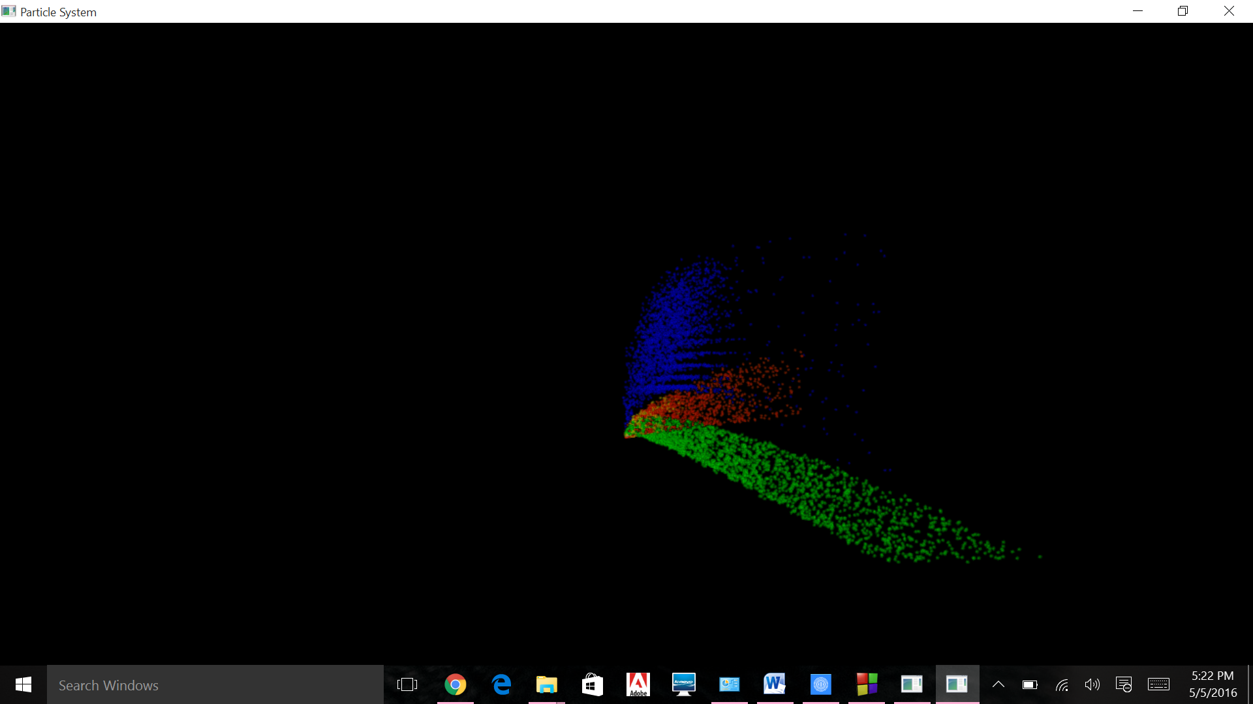
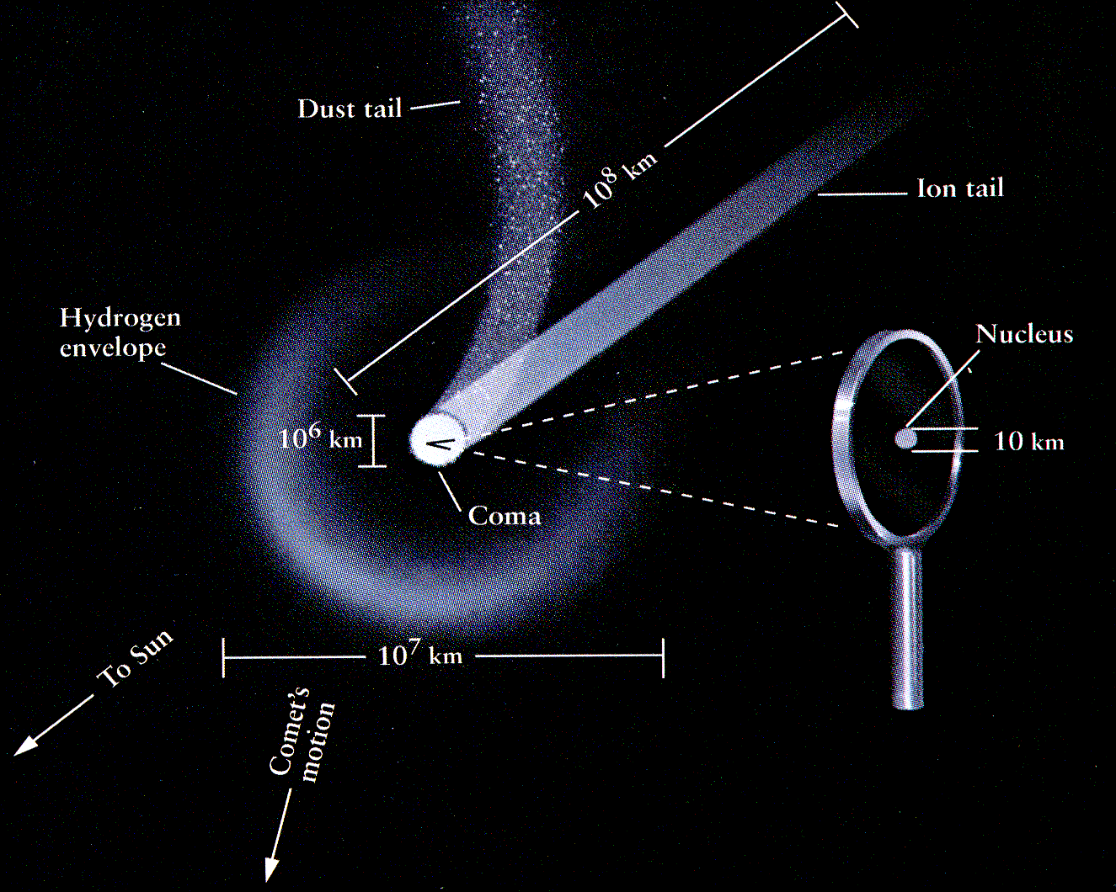
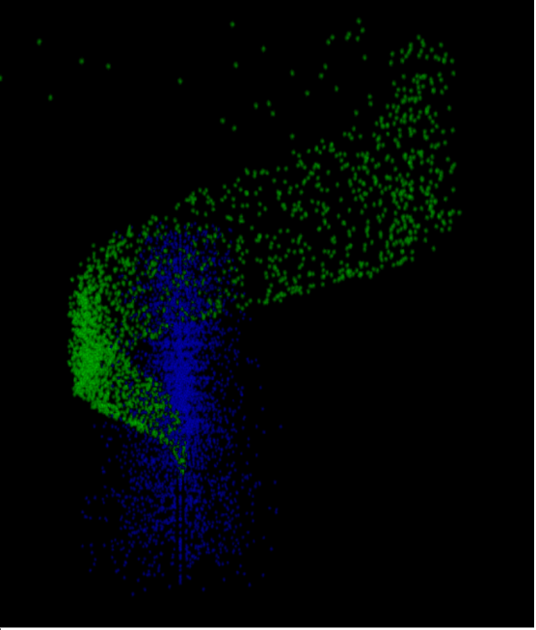
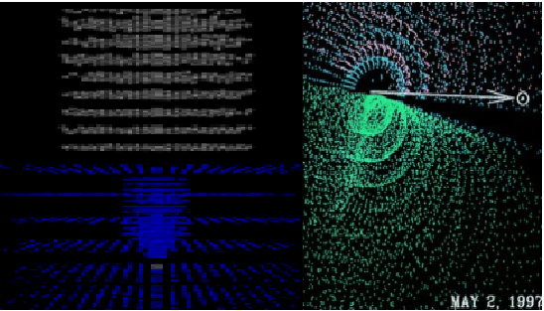
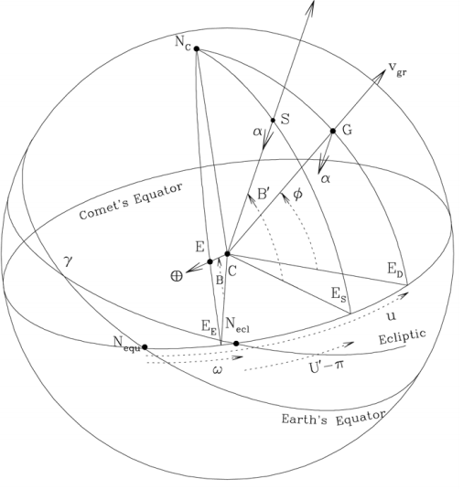
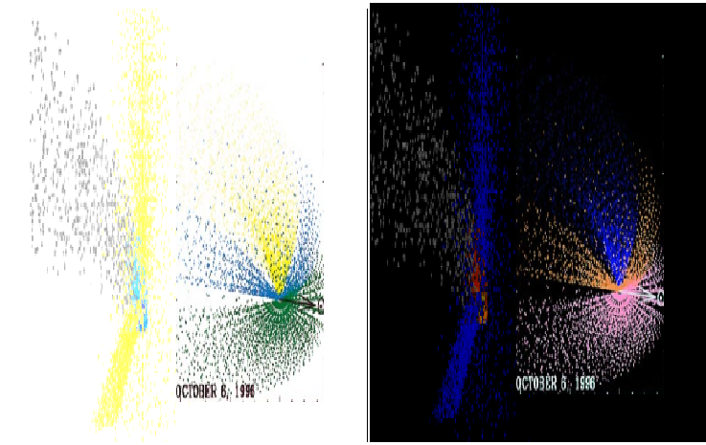
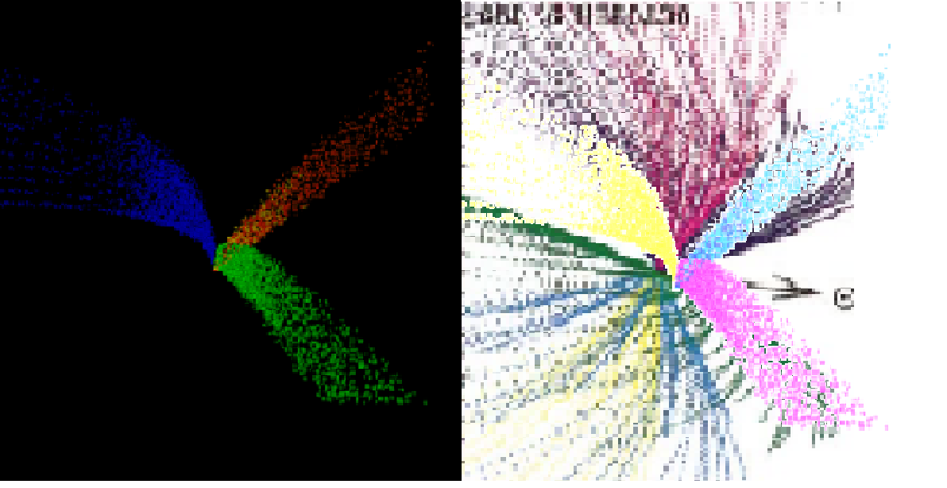
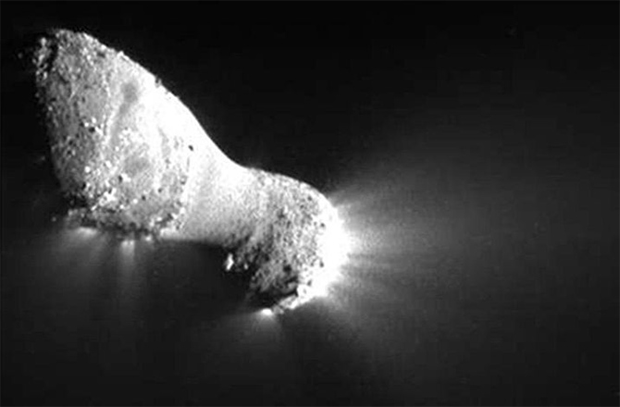
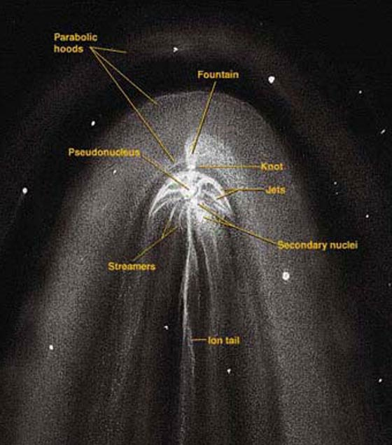
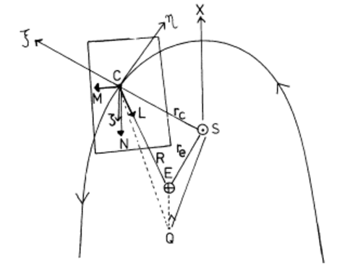
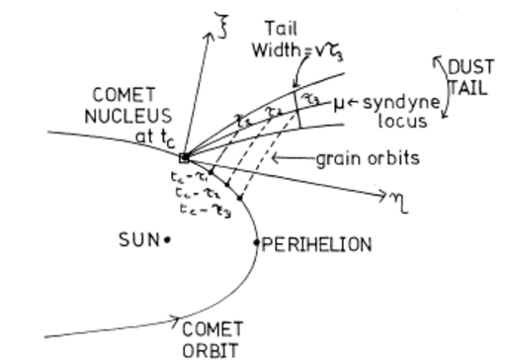
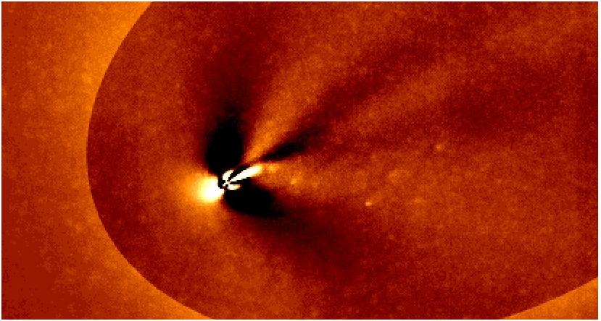
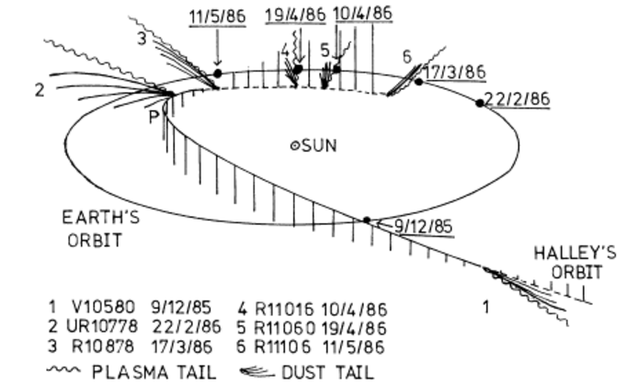
Graphical Simulation and Modelling of Inner Coma Outgassing Jets From Comets
Presented By: Arijit Das, Bachelor of Technology, Information Technology
Mentor : Dr. Pavan Chakraborty Indian Institute of Information Technology, Allahabad
INTRODUCTION
PROPOSED APPROACH
RESULTS
COMETS
COMPUTATION OF THE TRACK OF THE DUST GRAINS IN THE JETS
Velocity and Acceleration of the grains :
The sources are assumed to emit jets of gas and dust from local sunrise to sunset. Diurnal changes in production rates from the sources are neglected. A mean period of 11.34 h reported by Licandro et al. (1998), which is close to the value of 11.35 ± .04 h reported by Jorda et al. (1999) is used in the present analysis. On leaving the nucleus radially, the dust grains move under the combined force of solar radiation pressure and solar gravity. We neglect the gravitational force of the nucleus. The velocity vgr and acceleration α due to solar radiation pressure depend on the size and nature of the grains and the heliocentric distance. In the absence of the knowledge of the nature of the grains, we estimated α using the relation
α = βgsun(1)/r ^2 , (1)
where β is the ratio of the force due to solar radiation pressure on the grain to the gravitational force and ‘gsun’ is the acceleration due to solar gravity at one AU (0.6 × 10−5 km s−2). The velocity attained by the grains by the time the dust and gas get decoupled from each other within a few nuclear radii (Probstein 1969) was calculated using the empirical relation by Sekanina (1981b)
1 vgr = a + b √β , (2)
where a and b are coefficients which depend on the velocity of the gas driving the dust, dust and gas production rates, nature of the dust grain, and the nuclear radius. Sekanina and Larson (1984) have used this equation, with success, for dust emission from discrete sources and pointed out that the linear relation between (1/vgr, 1/ √β) in Eq. (2) is valid for grains with β ≤ 0.6 with slightly absorbing grains. Here we assume β to vary between 0.03 and 0.8 and that Probstein’s approach is applicable.
The Geometry
Modelled Nucleus
Finson-Probstein Model
A celestial object consisting of a nucleus of ice and dust and, when near the sun, a ‘tail’ of gas and dust particles pointing away from the sun.
Inner Coma Outgassing Jets Simulation
PHYSICAL CHARACTERISTICS
1.Nucleus 2.Coma 3.Tail 4.Jets
DUST SHELLS DEPICTED
Figure: Geometry indicating the location of the source G and the directions of the initial velocity vgr and acceleration α of the ejected grain. The sub-Sun point, sub-Earth point, and the North pole of the comet are S, E, and NC , respectively
Image Superposition
PROBLEM DEFINITION
r’ cos φ’ cos u’ = vgrt cos φ cos u − (1/2)αt 2 cos B’ cos U’’
r’ cos φ’ sin u’ = vgrt cos φ sin u − (1/2)αt 2 cos B’ sin U’’
r’sin φ’ = vgrt sin φ − (1/2)αt 2 sin B’
Our main objective is to model the outgassing jets from comet and to simulate the effects of sun’s gravity and spontaneous
radiations on the outgassing jets as well as to model the
trajectories of the gas and dust particles with respect to
rotation and typical motion of any comet in general. Basically
we are creating a tool or SRS(Software Resource Service)to
analyse any comet characteristics visually. At macroscopic
level, Finson-Probstein Dynamic Theory is utilised to plot the
Tail structure as a model of grid formed by Syndynes and
Synchrones.
Finson-Probstein Dynamical Theory to Model the Syndynes and Synchrones
In the tail, dust and gas are decoupled and the only significant forces affecting the grain trajectories are the solar gravity and radiation pressure. Both forces depend on the square of the heliocentric distance but work in opposite directions. Their sum can be seen as a reduced solar gravity, and the equation of motion is simply m × a = (1 − β) × Sungravity, where β is the ratio Pradiation/Sungravity, and is inversely proportional to the size of the grains for particles larger than 1 micron. From this relation, Finson & Probstein (1968, [7]) proposed a model which describes the full tail geometry with a grid of synchrones and syndynes
COMET JETS
CONCLUSION
Jets from Surface
The simulation adopts advanced technique to virtually create a system and to compute important aspects of Inner Coma Outgassing Jets from Comet. The Particle System Class and the Finson-Probstein Dynamic Theory are the key theories used in the simulation. The results shown, depicts the superposed images which verifies the trajectories of the dust jets and the nature of the dust particles. The models help to study the evolution of comets over time.
REFERENCES
[1] R.Vasundhara and Pavan Chakraborty “Modeling of Jets from Comet Hale–Bopp (C/1995 O1): Observations from the Vainu Bappu Observatory” Indian Institute of Astrophysics, Bangalore 500034, India
[2] Sharyl.M.Byram “The Effects of Dust Trajectory” Indian Institute of Information Technology, Allahabad 211012, Uttar Pradesh, India.
[3] Sekanina, Z., and S. M. Larson 1984.” Coma morphology and dust emission pattern of periodic Comet Halley. II. Nucleus spin vector and modeling of major dust features in 1910”. Astron. J. 89, 1408–1425.
Image Taken from
Dr.Pavan Chakraborty, PhD Thesis

